Slide 1



ADDING SEARCH & VALIDATION

Slide 2
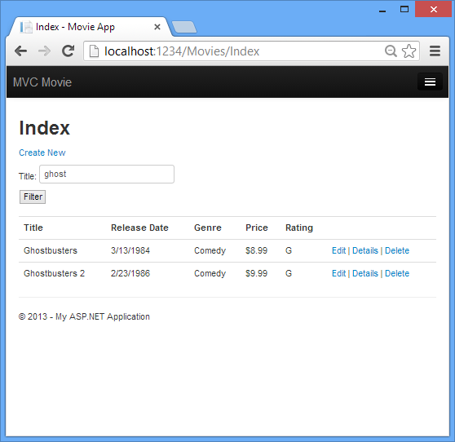



Search form – Index.cshtml
Enter a text filtering value.

Slide 3






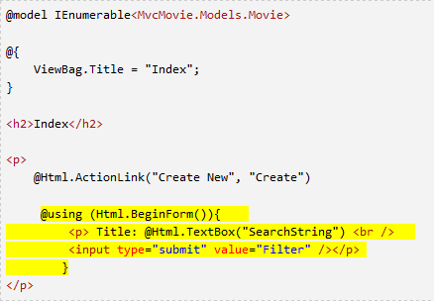
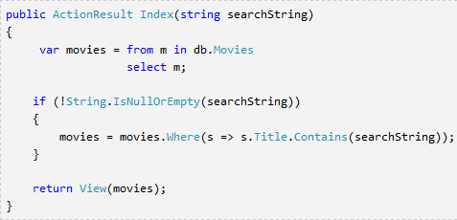












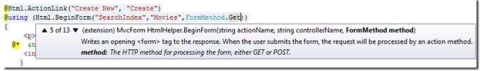
View/Controller – changes
Controller – changed signature of
View (changes)
the method Index.
LINQ query definition (NOT execution!)
Default form
method = POST!
Lambda expression
Use overriden BeginForm method to force HttpGet method.

Slide 4






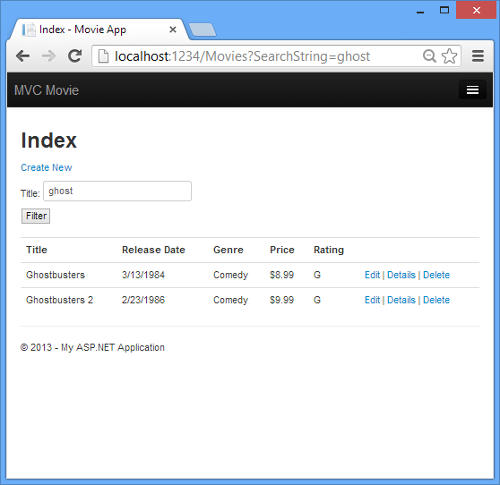
Searching movies – URL query
HTTP POST
HTTP GET

Slide 5



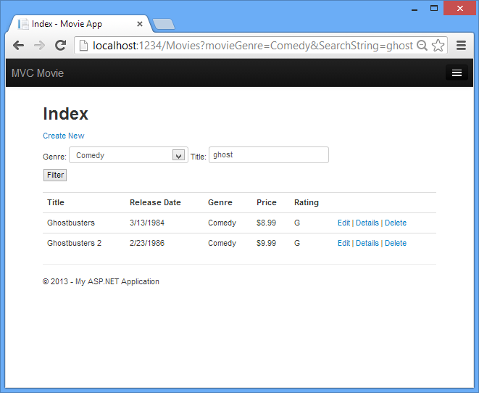
Adding search by Genre
HttpGet method handles the request.

Slide 6
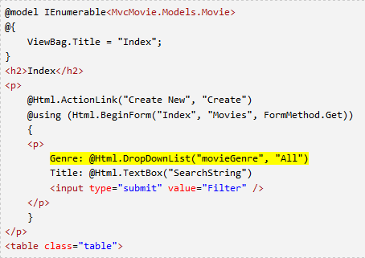









Search by Genre – View
Preselected value.
DropDown list markup.
Parameter “movieGenre” is the key for populating dropdown list from ViewBag.

Slide 7
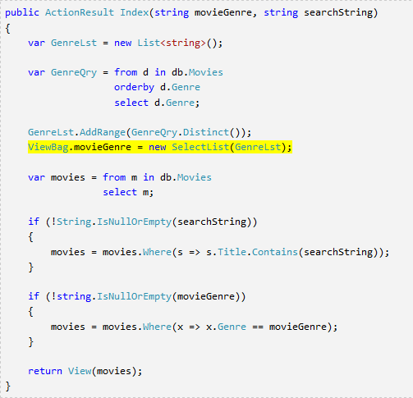






Search by Genre – Controller
Populating the list of genres in ViewBag.
Key movieGenre is the same as the parameter of the dropdown list.

Slide 8
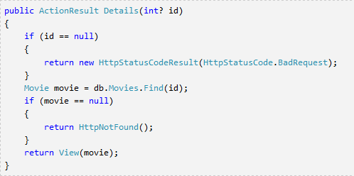
Details method - Controller

Slide 9






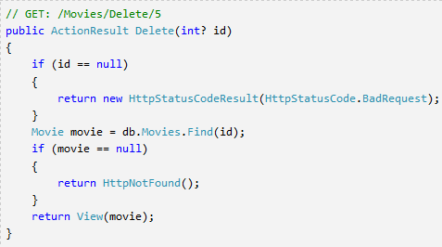
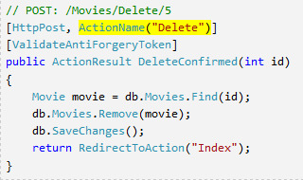






Delete method - Controller
HttpGet method.
Selects an objects and returns Details page.
Asp .net maps a segment of URL to a method.
Attribute ActionName is necessary to provide valid URL routing.
The same URL maps to different action methods, based on used HTTP method.
RULE:
Never use a HttpGet method
to modify the model. Opens security holes, architecturally bad!
HttpPost method. Deletes an object having the given id.

Slide 10
Data Validation
Keep Things DRY (Don’t Repeat Yourself)
Declarative validation rules in one place(Model class)
Regular expressions
Range validation
Length validation
NULL values validation
Data formatting
Validation rules enforced before saving changes to the database!

Slide 11
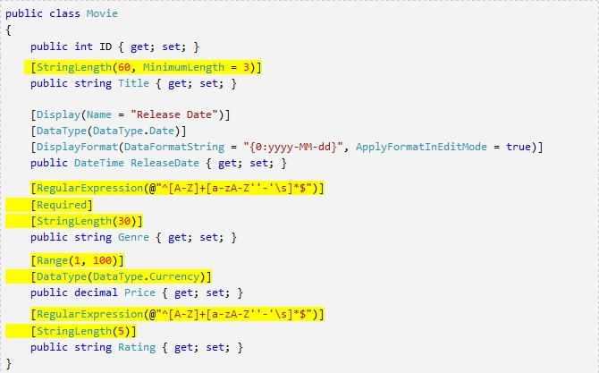
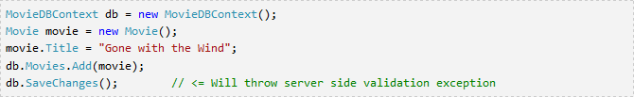



Validation rules – Model
Several validation rules failed.

Slide 12
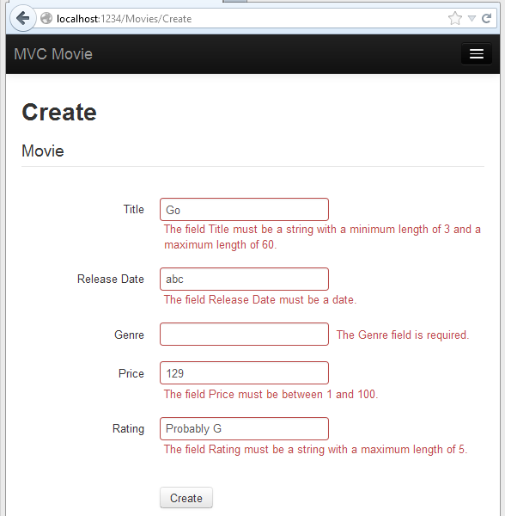








Data Validation - View
Client-side validation: javascript (jQuery).
Validation rules picked up from the
model class annotations.
Validation messages derived from the validation constraints in the model class.

Slide 13
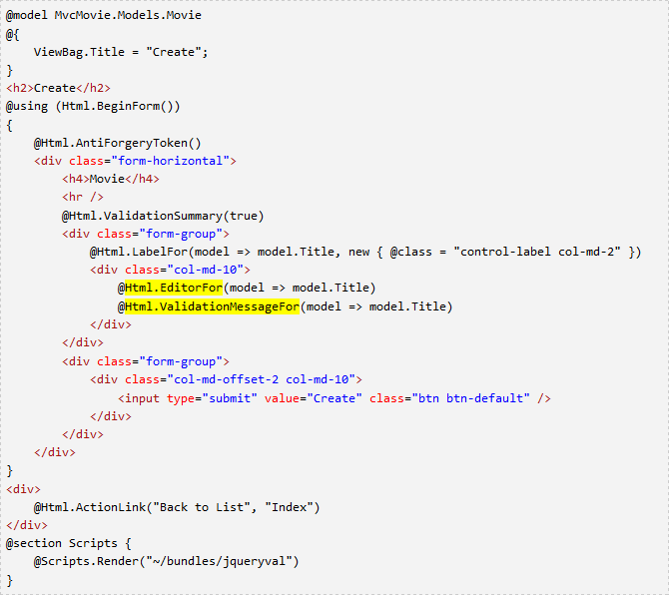



Data Validation – View (cont.)
Validation message derived from the validation constraints specified for the given Property (Title)

Slide 14
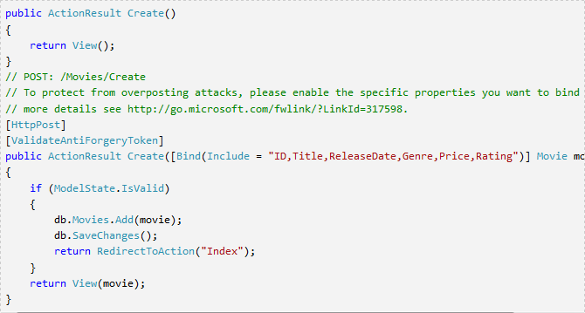




Data Validation - Controller
HttpGet method displays initial Create form.
HttpPost method that does create a new object.
Server-side data validation check.

Slide 15
DataType attributes
Provide only hits for the view engine to format the data
Date, Time, PhoneNumber, EmailAddress,…
Automatic provision of type specific features
e.g. “mailto: ...” link for EmailAddress
Do NOT provide any Validation (just presentation hints)

Slide 16
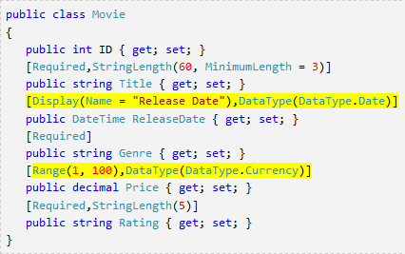



DisplayFormat annotation
Used to explicitly specify format of the data
Example: redefining the default date format
It is possible to specify validation
properties in one line!

